Slide 1

Personal Analytics for Faculty
FAST National University of Computer
& Emerging Sciences, Peshawar.
Group Members:
Mujtaba Ali (p13-6134)
Ghulam Abbas(p13-6137)
Supervisor:
Sir Shoaib Muhammad

Slide 2
Personal Analytics

Slide 3
Personal Analytics (1/2)
Collect your personal data
Process the collected data
And gain a wide range of information about yourself.
Also called quantified self, self-tracking and personal informatics

Slide 4
Personal Analytics (2/2)
It helps in
Knowing your personality, choices and priorities
Decision making
Improving your routine

Slide 5
Project Description

Slide 6
Project Description (1/2)
Based on personal analytics
measurement of the time spent on
Research versus Teaching activities
Generate graphs for the result

Slide 7
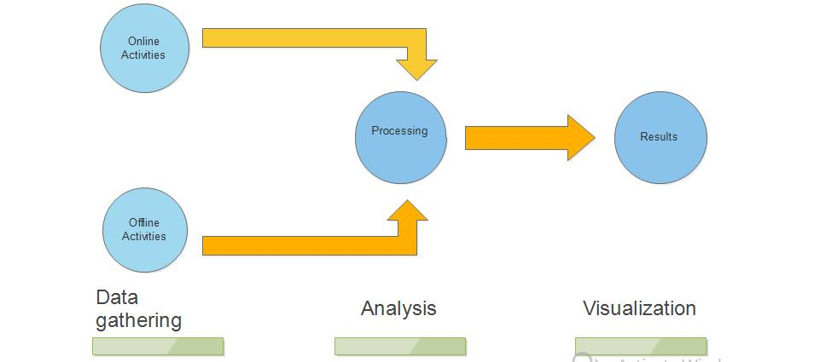
Project Description (2/2)
Workflow:

Slide 8
Motivation (1/1)
Difficulty in self evaluation
Unable to moderate activities
Hence problem in time management

Slide 9
Objective (1/1)
To facilitate the faculty by automatic measurement of their time spent on Research versus Teaching activities on a computer

Slide 10
SWOT Analysis

Slide 11
SWOT Analysis (1/4)
Strengths:
Automatic and Context based categorization of activities.
Continuously monitoring the users activities in background without any interruption
Can read textual data from multiple file formats
Helps in moderating activities.

Slide 12
SWOT Analysis (2/4)
Weaknesses:
Cannot analyze contents of video or audio.
It can analyze only materials texted in English Language.
Cannot differentiate if multiple sessions are active at the same time using multiple windows restored down.

Slide 13
SWOT Analysis (3/4)
Opportunities:
Extendable to categorization of other activities.
Can be used to develop a scheduler.

Slide 14
SWOT Analysis (4/4)
Threats:
Data corruption/loss.

Slide 15
Scope
For: Academia/faculty
Nature: Research And Teaching Activities
Sources: Only online and offline activities
Language Support: English Language support only

Slide 16
FYP1 Milestone
Activity Monitoring
Processing on the basis of meta data

